Slide 1
Cloud System Architecture & Design
Apache Kafka on AWS

Slide 2

Problem Statement
Data Infrastructure on the Cloud.
Existing Infrastructure for Processing Images:
Web Application collecting Images uploaded by Customers.
Web Application providing Images using a Kafka Stream.
Code from Software Engineers to process Images.
A New Cloud System Architecture & Design is needed.

Slide 3

Objectives & Tasks
Objectives:
Save Processed Images for a Minimum of 7 Days.
Provide Archival Tools and Solutions.
Business Intelligence on Key Statistics.
Data on Customers, Number & Type of Images Processed.
Tasks:
Provide a System Architecture Diagram.
Any Commercial Cloud Providers’ Ecosystem.
Indicate Assumptions & Justifications on Decisions.
Provide Pros & Cons of System Architecture & Design.

Slide 4


Best Practices for Running Apache Kafka on AWS
Adapted from the AWS Big Data Blog.
Article: Best Practices for Running Apache Kafka on AWS.
Reference: https://aws.amazon.com/blogs/big-data/best-practices-for-running-apache-kafka-on-aws/.
Deployment Considerations & Patterns:
Single AWS Region, Three Availability Zones, All Active.
Single Region, Three Availability Zones, Active-Standby.

Slide 5
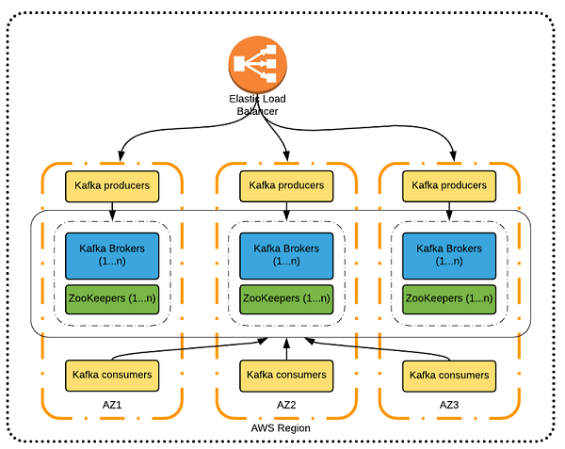
First Deployment Pattern
Single AWS Region, Three Availability Zones, All Active.

Slide 6
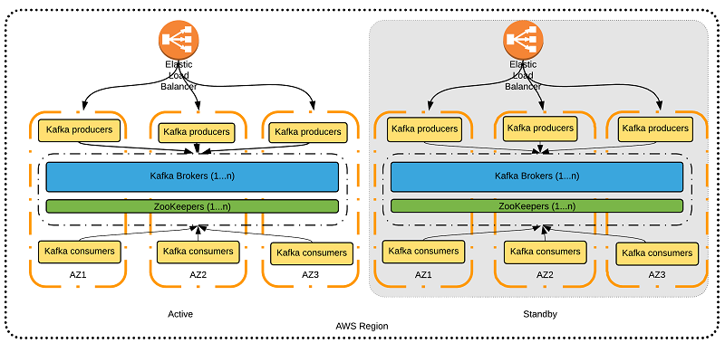
Second Deployment Pattern
Single Region, Three Availability Zones, Active-Standby.

Slide 7

Summary & Conclusion
High Performance & Scalable Solution to Ingest Streaming Data.
A Successful Deployment Considers these Options:
Availability.
Consistency.
Operational Overhead.
Pros & Cons of Each Deployment.
Considerations for Business Intelligence:
Number and Size of Images, Processed & Raw.
Monitoring and Failure Handling of Data Streams.
Operational Issues with Deployment of Cloud Systems.

